Slide 1
ALSA Recorder: Record What We Hear From Computer
Norrathep Rattanavipanon
Erik Efrain Henriquez

Slide 2

Motivation
Learn how to record streaming data
Protected and unprotected
Video and audio
Same quality
Focus on protected audio data
Spotify on Linux

Slide 3
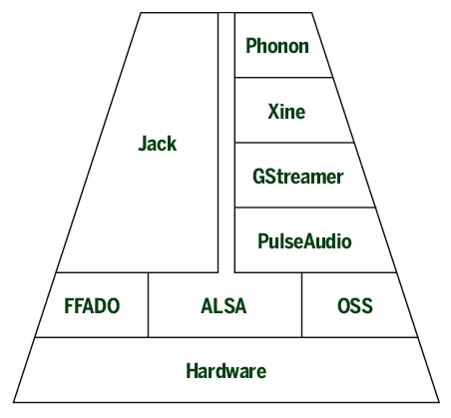
Audio Layer in Linux
Many frontends
PulseAudio is popular
Still use underlying interfaces to communicate with hardware
Advanced Linux Sound Architecture (ALSA)
Gives applications a direct interface to hardware devices (i.e. sound cards)
Well-established open-source interface

Slide 4
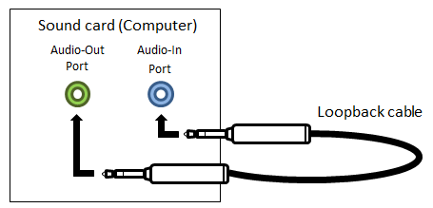
Existing method : Redirecting audio
ALSA Configuration
Write Stereo Mix to a file
Audacity
Manually specify the program that’s being recorded

Slide 5
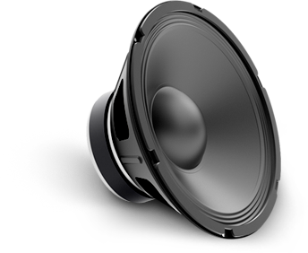

Design
Audio data is decrypted before calling ALSA
Modify ALSA source code
Whenever play an audio, buffer it and save a copy as a raw audio file.
Process a raw file into WAV / MP3 file later
Mod ALSA
Audio Source
buf
buf
copy

Slide 6
Design
Audio data is decrypted before calling ALSA
Modify ALSA source code
Whenever play an audio from buffer, save a copy as a raw audio file. Process a raw file into WAV file later
Two methods
Kernel layer
API layer

Slide 7
Method 1 : Kernel Layer
Linux/sound/core/pcm_native.c
Function snd_pcm_playback_ioctl1

Slide 8
Method 1 : Kernel Layer
static int snd_pcm_playback_ioctl1(struct file *file, struct snd_pcm_substream *substream, unsigned int cmd, void __user *arg) { ... switch (cmd) { case SNDRV_PCM_IOCTL_WRITEI_FRAMES: { ...
result = snd_pcm_lib_write(substream, xferi.buf, xferi.frames); __put_user(result, &_xferi->result);
...
}
...
}

Slide 9
Method 1 : Kernel Layer
static int snd_pcm_playback_ioctl1(struct file *file, struct snd_pcm_substream *substream, unsigned int cmd, void __user *arg) { ... switch (cmd) { case SNDRV_PCM_IOCTL_WRITEI_FRAMES: { ...
result = snd_pcm_lib_write(substream, xferi.buf, xferi.frames); __put_user(result, &_xferi->result); struct file *rfp = file_open("out.raw"); file_write(rfp, (char*) xferi.buf, xferi.frames);
...
}
...
}

Slide 10
Method 2 : API Layer
snd_pcm_writei in alsa-lib
snd_pcm_sframes_t snd_pcm_writei(snd_pcm_t *pcm,
const void *buffer, snd_pcm_uframes_t size)
{
…
saveToFile(buffer)
return _snd_pcm_writei(pcm, buffer, size);
}

Slide 11
What if we can’t re-compile API source code
Spotify
write(buffer)
ALSA

Slide 12
What if we can’t re-compile API source code
Monkey Patching - LD_PRELOAD + dlsym(RTLD_NEXT, funcName)
Replace fn at runtime
my-alsa-write
Spotify
alsa-write(buf)
alsa-write(buf)
My shared library
ALSA
Can do whatever I want with “buf”

Slide 13
Evaluation
Unprotected local audio file
aplay cartoon.wav
Protected streaming media - Spotify
1 recorded song takes 20 MB of space - we can compress
Same quality as the stream

Slide 14
Lesson Learned
Build kernel, modules and ALSA source code
Search source code
cscope!
Don’t use virtual machine for kernel development!
esp device driver

Slide 15
Future work
Sound mixer
Capture video too

Slide 16
Demo - preload method

Slide 17
Questions

Slide 18
How it works
Start.sh : create a file, start.oak
Modify source code : write()
Only write to out.raw only when start.oak exists
Stop.sh : convert out.raw to out.wav and remove start.oak

